Slide 1
Web Application Testing MOLDCELL MOLDOVA
Final Project

Slide 2

APP DESCRIPTION
Moldcell Moldova
Mobile network operator
WEB Application
Online store for products and services
National shipping
B2B & B2C e-commerce site

Slide 3
TESTING APPROACH
Understanding the functionality of the web application and clearly define the scope of testing
Exploratory Testing for main functionalities
Apply testing techniques such as equivalence class partition, boundary value analysis and write test cases for the high-level functionalities
Component Testing, Integration, System, System Integration Testing
Execute the test cases and compare expected and actual results
Focus where bugs were identified, more testing for that area
Write the Smoke Tests and execute them
Write the Test Report

Slide 4





TOOLS USED
Xmind Tool – Mind Maps
Mantis Bug Tracker – Bug Reporting
Microsoft Excel – Test Case Management, Test Data
Microsoft Word – Test Report
Lightshot Screenshot – Screenshots Capture

Slide 5
TESTING TYPES
PERFORMED
APPLICABLE
Functional Testing
ExploratoryTesting
Negative Testing
Positive Testing
Smoke Testing
Compatibility Testing
UI Testing
Usability Testing
Performance Testing
Security Testing

Slide 6
BUGS OVERVIEW
TOTAL: 21 BUGS

Slide 7
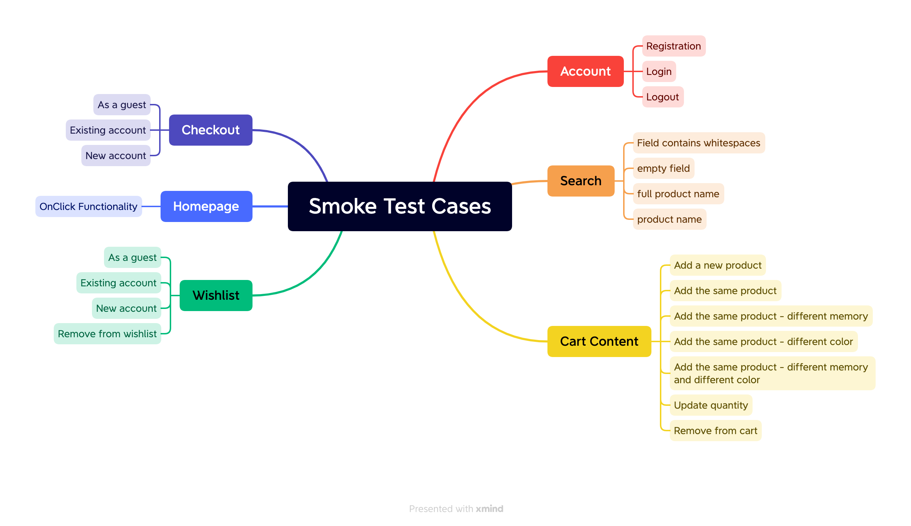
TEST CASES OVERVIEW
Total: 22 Smoke Test Cases

Slide 8
TEST CASES RESULTS
Functionality | Total | Pass | Failed | Blocked | Not Run | Defects
Homepage | 1 | 1 | 0 | 0 | 0
Account | 3 | 3 | 0 | 0 | 0
Cart content | 7 | 5 | 0 | 2 | 0 | 0047492, 0047497
Wishlist | 4 | 3 | 1 | 0 | 0 | 0047506
Checkout | 3 | 3 | 0 | 0 | 0
Search | 4 | 1 | 3 | 0 | 0 | 0047571, 0047572, 0047573
Overall Results | 22 | 16 | 4 | 2 | 0 | 6

Slide 9
CONCLUSIONS
Smoke Test Cases (happy flows), for the main functionalities in a percent of 100% were executed, 78% passed and 22% failed. The failed test cases are related to the Cart content, Wishlist and Search functionality.
A total number of 21 new bugs were identified, most of them were identified as normal severity (11 bugs), 4 of them as blocker severity and the rest of 6 bugs were major severity. No bugs were validated.
In addition to Smoke and Positive testing, testing types such as: Functional Testing, Exploratory, Compatibility, Negative, UI, Usability, were covered.
Exploratory testing was performed for important functionalities. A large number of bugs were identified during exploratory testing, 7 of them are normal, 6 of them are major and 2 of them are blocker. Most of them are related to the Registration, Account settings, but also for other functionalities.
Most of the bugs were identified by Negative Testing.
Compatibility testing was also performed, for different browsers. The bugs reproduce on all browsers. The main functionalities are working the same with other environment.
Considering the number of high severity bugs identified, on all important functionalities, the fixing of at least the major severity bugs is recommended, although the application is already in production.

Slide 10
LESSONS LEARNED
Finding a buggy app was a challenge
Lack of requirements
Write the test cases clear, simple, easy to read and understand
Bug report: complete steps, easy to follow
Use real data for testing
Exploratory Testing is very helpful if the requirements are missing
Testing never ends
Think outside the box
Attention to details

